Slide 1
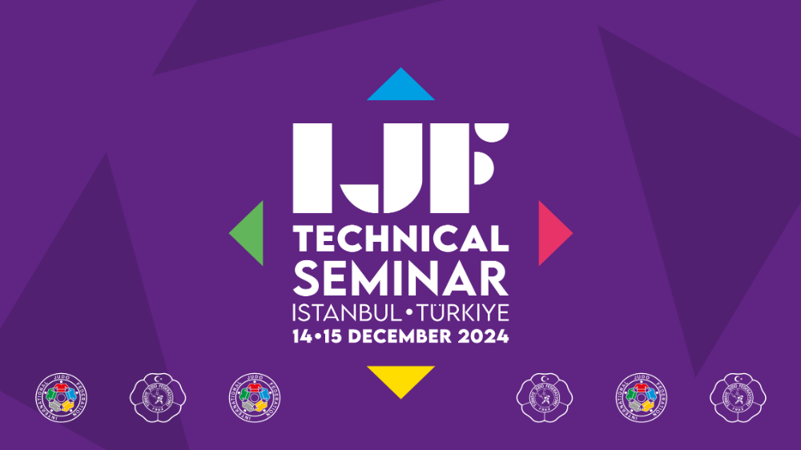

Slide 2
08:30 Opening
09:00 – 10:30 Seminar
10:30 – 11:00 Coffee break
11:00 – 12:00 Seminar
15:00 – 16:30 Seminar
16:30 – 17:00 Coffee break
17:00 – 18:00 Seminar

Slide 3
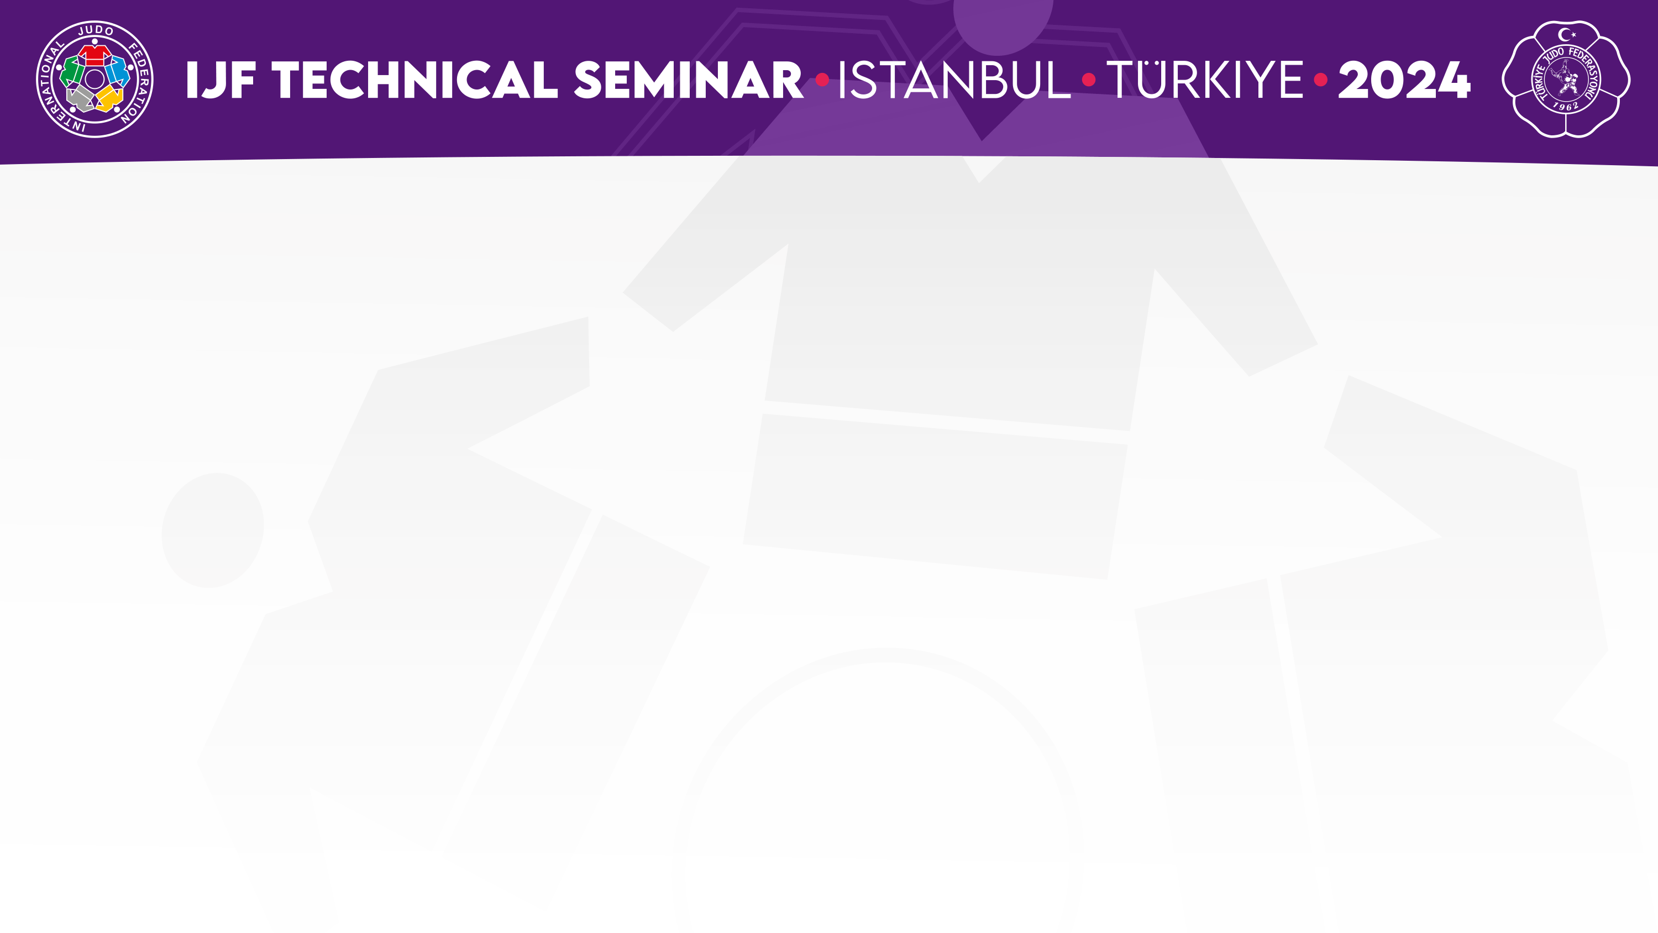
Refereeing Commission

Slide 4
Scores in Tachi-waza
Ippon
Waza-ari & Waza-ari-awasete-ippon
Yuko scores are counted (1, 2, 3, etc.) but they do not add up to Waza-ari

Slide 5
Scores in Tachi-waza
Ippon: unchanged
Waza-ari: landing more than 90 degrees of the shoulder axis, but not on the back

Slide 6
Scores in Tachi-waza
Yuko in Tachi-waza is defined as:
- Side landing (90 degrees) or close to side landing
- Landing on upper back
- Landing on the the side on the shoulder axis and on elbow
- Landing on buttocks (Yuko and no Shido)

Slide 7
Scores in Tachi-waza
Yuko will not be awarded, even if the shoulder axis is 90 degrees or close to 90 degrees, if:
the front part of the stomach,
the front part of the hip or
the knee to the front are touching the mat.

Slide 8
Osaekomi time
Ippon: 20 sec
Waza-ari: 10 sec or more, but less than 20 sec (10-19 sec)
Yuko: 5 sec or more, but less than 10 sec (5-9 sec)

Slide 9
Bear hug
Bear hug in tachi-waza is allowed, excepted with hands or hands and arms clasped, forming a circle which will be penalised with Shido.

Slide 10
Reverse Seoi-nage
Reverse Seoi-nage at senior and junior events is allowed .
Reverse Seoi-nage at cadet events will be penalised with Shido

Slide 11
Tori using the head
In senior and junior events Tori is allowed to use the head to throw.
In cadet events athletes are not allowed to use the head to throw as Tori, they will be penalised with Shido.

Slide 12
Uke applying head defence
In senior and junior events Uke is allowed to use the head to defend.
In cadet events athletes are not allowed to use the head to defend as Uke. In this situation, Tori will be awarded a score, if any, and Uke will be penalised with Shido.
Note: Landing on bridge will still be considered Ippon!`

Slide 13
Diving
To “dive” headfirst onto the tatami, be bending forward and downward while performing or attempting to perform techniques such as Uchi-mata, Harai-goshi, Seoi-nage, Tai-otoshi, Kata-guruma, Tsuri-goshi, Ura-nage etc. it is forbidden to somersault forward when Uke is on the shoulders or the back of tori, and will be penalised with Hansokumake.

Slide 14
Gripping under the belt
All jacket grips and gripping under the belt to the level of the top the inner thigh are allowed
but
if using negatively jacket and under the belt to the level of the top of the inner tights, Shido will be given.

Slide 15
Gripping under the belt
Hooking the legs with the hand or arm, leg grabbing, gripping trousers and touching the leg from the top of inner thigh down is forbidden and will be penalised with Shido.

Slide 16
Grips inside jacket and trousers
In Tachi-waza it is allowed to grip inside the sleeve as Tori and as Uke.
In Tachi-waza it is not allowed to grip inside the trousers (down) as Tori and as Uke, and will be penalised with Shido.
In Ne-waza it is allowed to grip inside the sleeve as Tori and as Uke.
In Ne-waza it is allowed the grip inside the trouser as Tori and as Uke.

Slide 17
Kansetsu-waza & Shime-waza
Applying Kansetsu-waza or Shime-waza in Tachi-waza without a judo throwing technique, or with a judo throwing technique with a lower risk of injury, where Uke has the possibility to escape, performed with one or two hands on one arm will be penalised with Shido.

Slide 18
Kansetsu-waza & Shime-waza
Applying Kansetsu-waza or Shime-waza in Tachi-waza with a judo throwing technique with a higher risk of injury, where Uke has no possibility to escape, performed with one or two hands on one arm will be penalised with Hansokumake.

Slide 19
False attack
False attack is considered when:
- Tori has no intention to throw.
- Tori attacks without kumikata or immediately release the kumikata.
- Tor makes a single fake attack or several repeated fake attacks with no breaking of Uke’s balance.
- Tori puts a leg in between ukes legs to block the possibility of an attack.
- Tori has no realistic possibility to throw (new).

Slide 20
Stepping outside contest area
In Tachi-waza to go intentionally outside the contest area will be penalised with Shido.
In Ne-waza to go intentionally outside the contest area will be penalised with Shido.

Slide 21
Kumikata
The time between conventional kumikata (classic Hikite and Tsurite)` and making an attack is 30 seconds if there is a positive progression.

Slide 22
Osaekomi
A throwing score will be awarded if there is a Kodokan classified throwing technique or variation of it, with continuity and valid landing.
An “Osaekomi!” will be called if there is a Kodokan classified Osaekomi-waza technique or a variation of it, fixing and control.

Slide 23
Shido in Cadet Competitions
- In cadet events athletes are not allowed to use the head to throw as Tori, they will be penalised with Shido.
- In cadet events athletes are not allowed to use the head to defend as Uke. In this situation, Tori will be awarded a score, if any, and Uke will be penalised with Shido.
- In cadet events there will be no score for reverse Seoi-nage, but penalised with Shido.

Slide 24
Techniques allowed
- There are Kodokan classified judo techniques allowed for all age groups.
- There are Kodokan classified techniques partial allowed (Tachi-waza vs Ne-waza; senior/junior vs cadet events)
- There are Kodokan classified judo techniques are not allowed (Kawazu-gake, Kani-Basami, Do-jime, Ashi-garami).

Slide 25

Thank you
Merci
Muchas gracias

